Slide 1

Is Moore’s Law Dead?
Ty Davis – ECE 3000

Slide 2

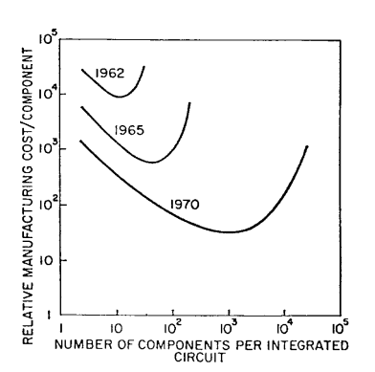
Moore’s Law - History
"With unit cost falling as the number of components per circuit rises, by 1975 economics may dictate squeezing as many as 65,000 components on a single silicon chip."
- Gordon Moore
Intel’s flagship Core i9 13900k CPU (Sept, 2022) boasts a transistor count of up to 26 billion.

Slide 3
Moore’s Law - History
"Four main factors are responsible for most of this increase in chip density:
Die size
Line dimension
Technical cleverness
Technical innovation
Together, they serve to explain most of the exponential improvements in transistors per chip described by Moore’s law."
- Ethan Mollick

Slide 4
Moore’s Law – Difficulties
Manufacturing small transistors is difficult and expensive.
“Further reduction in insulator thickness would have resulted in unacceptable (and exponential) increases in gate leakage current through direct quantum tunneling.” – Theis and Wong
“Further reduction in operating voltage swing would have resulted in either unacceptably low channel current in the ‘on’ state (unacceptable decreases in switching speed) or increased leakage current in the ‘off’ state (unacceptable increases in passive power).” – Theis and Wong

Slide 5
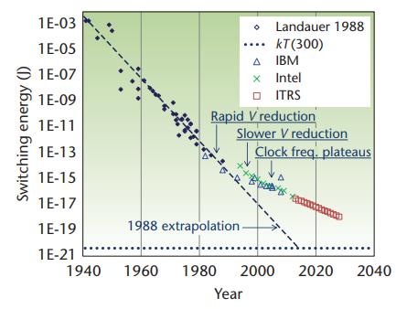
Moore’s Law – Difficulties
The amount of energy required for switching transistors is experiencing diminishing returns.

Slide 6
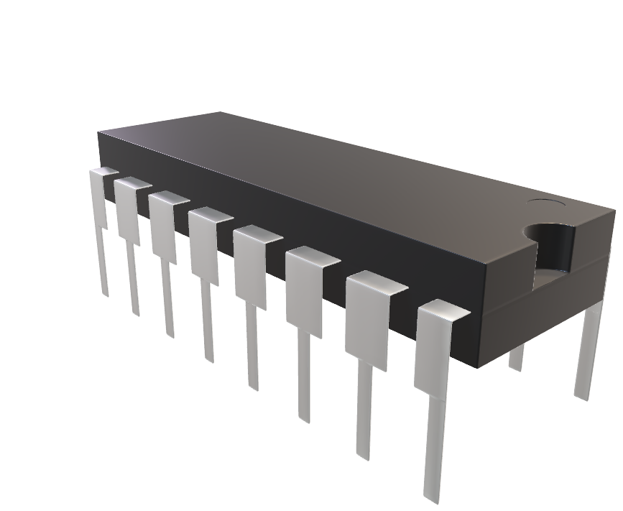
Moore’s Law – The Future?
“When transistors can’t get any smaller, the only direction is up.”
- Radosavljevic and Kavalieros

Slide 7
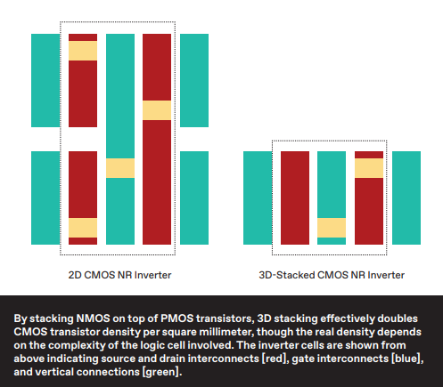
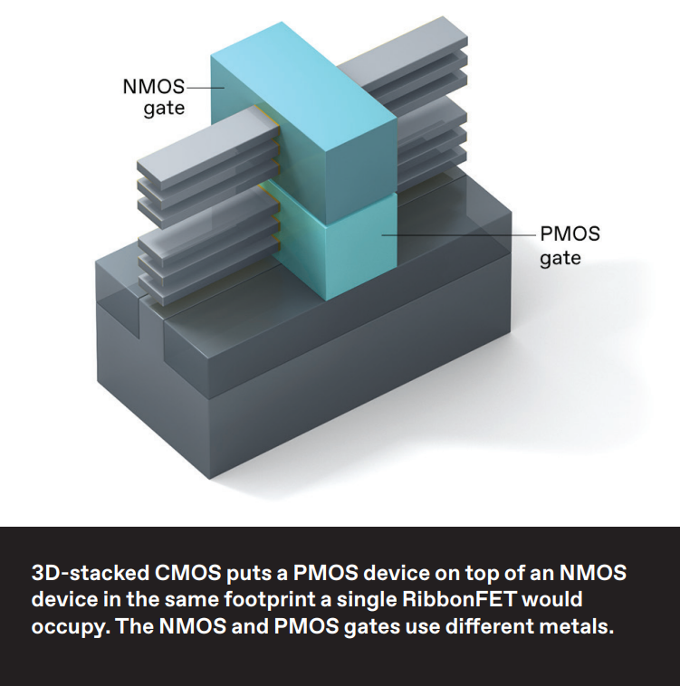
Moore’s Law – The Future?

Slide 8
Moore’s Law – The Future?
“We’ve made wafers where the smallest distance between two sets of stacked devices is only 55 nm. While the device performance results we achieved are not records in and of themselves, they do compare well with individual non-stacked control devices built on the same wafer with the same processing.”
- Radosavljevic and Kavalieros

Slide 9
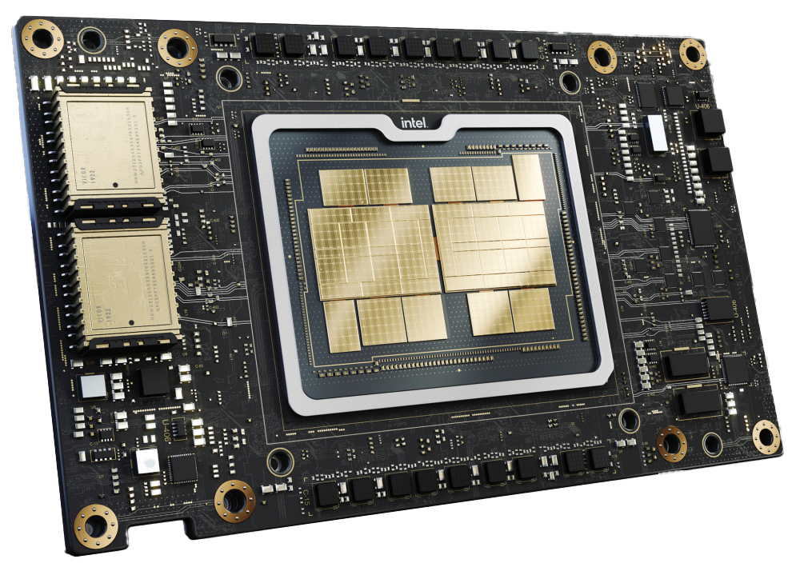
Moore’s Law – 3D Chip Design in Circuits Today
Intel’s Ponte Vecchio Supercomputer Chip
Recently “pierced the exaflop barrier”
“Using both 2.5D and 3D technologies, Intel squeezed 3,100 square millimeters of silicon—nearly equal to four Nvidia A100 GPUs—into a 2,330-mm2 footprint.”
– SK Moore

Slide 10
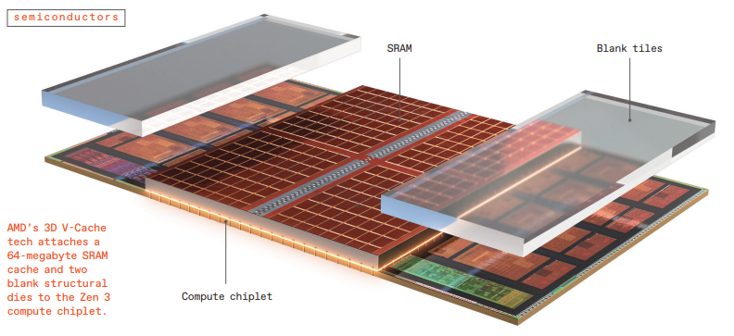
Moore’s Law – 3D Chip Design in Circuits Today
AMD’s Zen 3 with 3D V-Cache
“Despite tripling the L3 [cache] size, 3D V-Cache only added four [clock] cycles of latency—something that could only be achieved through 3D stacking”
- John Wuu, AMD senior engineer
“Using the ... 3D V-Cache sped games rendered at 1080p by an average of 15 percent.”
– SK Moore

Slide 11
Moore’s Law – Will it persist?
The processing power of a computer chip doubles every one to two years.
Do we need to rethink computing?

Slide 12
References
DeBenedictis, Erik P. “It’s Time to Redefine Moore’s Law Again.” Computer, vol. 50, no. 2,2017, pp. 72–75. https://doi.org/10.1109/MC.2017.34.
Mollick, E. “Establishing Moore’s Law.” IEEE Annals of the History of Computing, vol. 28,no. 3, 2006, pp. 62–75. https://doi.org/10.1109/MAHC.2006.45.
Moore, Gordon E. “Cramming more components onto integrated circuits, Reprinted from Electronics, volume 38, number 8, April 19, 1965, pp.114 ff.” IEEE Solid-State Circuits Society Newsletter, vol. 11, no. 3, 2006, pp. 33–35. https://doi.org/10.1109/NSSC.2006.4785860.
Moore, Samuel K. “3 Paths to 3D Processors.” IEEE Spectrum, vol. 59, no. 6, 2022, pp. 24– 29. https://doi.org/10.1109/MSPEC.2022.9792148.
Radosavljevic, Marko, and Jack Kavalieros. “Taking Moore’s Law to New Heights: When transistors can’t get any smaller, the only direction is up.” IEEE Spectrum, vol. 59, no. 12,2022, pp. 32–37. https://doi.org/10.1109/MSPEC.2022.9976473.
Theis, Thomas N., and H.-S. Philip Wong. “The End of Moore’s Law: A New Beginning for Information Technology.” Computing in Science & Engineering, vol. 19, no. 2, 2017,pp. 41–50. https://doi.org/10.1109/MCSE.2017.29.
Williams, R. Stanley. “What’s Next? [The end of Moore’s law].” Computing in Science & Engineering, vol. 19, no. 2, 2017, pp. 7–13. https://doi.org/10.1109/MCSE.2017.31.

